Slide 1
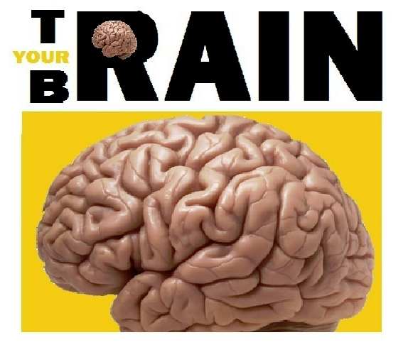
Assignment
Computer Science
A Study in Brain Training Methods
Abdul Rahim Khan
Nolan Chris Quadros

Slide 2
Index of Contents
Bonafide certificate
Acknowledgments
Program Definition
Programming Style
Code
Output
Conclusion

Slide 3
Acknowledgments
The end result of this little venture would not have been the same as it is now without the kind support and help of many individuals. I would like to extend my sincere thanks to all of them.
I am highly indebted to the Computer Science Department for their guidance and constant supervision as well as for providing necessary information regarding the project & also for their support in the completion of the project.
I would like to express my gratitude towards my parents & member of (Organization Name)for their kind co-operation and encouragement which has greatly helped me in the completion of this project.
I would like to express my special gratitude and thanks to our teacher, Mrs. Aparna for giving me such attention and time.
My thanks and appreciations also go to my colleague in developing the project and to all the people who have willingly helped me out with their abilities.

Slide 4
Program Definition
The main thrust of the program is to provide an easy fun way for aspiring geniuses to train their visual, mathematical and logical abilities to the maximum
Keeping entertainment in mind, an error free, addictive interface has been designed that serves the above cited purpose I the best manner possible.
Unlimited fun and entertainment, alongwith the very best brain training is guaranteed.

Slide 5
Programming Style
Programming language used is python
Additional modules used are pygame and autopy.
For the graphics basic software like MS-Paint and GIMP have been used.
Object oriented methodology has been strictly adhered to.
File management methods have been implemented
User accounts and score management systems are also a feature

Slide 6
About Python
Python is a widely used high-level, general-purpose, interpreted, dynamic programming language. Its design philosophy emphasizes code readability, and its syntax allows programmers to express concepts in fewer lines of code than possible in languages such as C++ or Java. The language provides constructs intended to enable writing clear programs on both a small and large scale.
Python supports multiple programming paradigms, including object-oriented, imperative and functional programming or procedural styles. It features a dynamic type system and automatic memory management and has a large and comprehensive standard library.
Python interpreters are available for many operating systems, allowing Python code to run on a wide variety of systems. CPython, the reference implementation of Python, is free and open-source software and has a community-based development model, as do nearly all of its variant implementations. CPython is managed by the non-profit Python Software Foundation.

Slide 7
Early History of Python
Python was conceived in the late 1980s, and its implementation began in December 1989 by Guido van Rossum at Centrum Wiskunde & Informatica (CWI) in the Netherlands as a successor to the ABC language (itself inspired by SETL) capable of exception handling and interfacing with the operating system Amoeba. Van Rossum is Python's principal author, and his continuing central role in deciding the direction of Python is reflected in the title given to him by the Python community, benevolent dictator for life (BDFL) .
About the origin of Python, Van Rossum wrote in 1996:
Over six years ago, in December 1989, I was looking for a "hobby" programming project that would keep me occupied during the week around Christmas. My office ... would be closed, but I had a home computer, and not much else on my hands. I decided to write an interpreter for the new scripting language I had been thinking about lately: a descendant of ABC that would appeal to Unix/C hackers. I chose Python as a working title for the project, being in a slightly irreverent mood (and a big fan of Monty Python's Flying Circus) .
Python 2.0 was released on 16 October 2000 and had many major new features, including a cycle-detecting garbage collector and support for Unicode. With this release the development process was changed and became more transparent and community-backed.
Python 3.0 (which early in its development was commonly referred to as Python 3000 or py3k), a major, backwards-incompatible release, was released on 3 December 2008 after a long period of testing. Many of its major features have been backported to the backwards-compatible Python 2.6.x and 2.7.x version series.

Slide 8


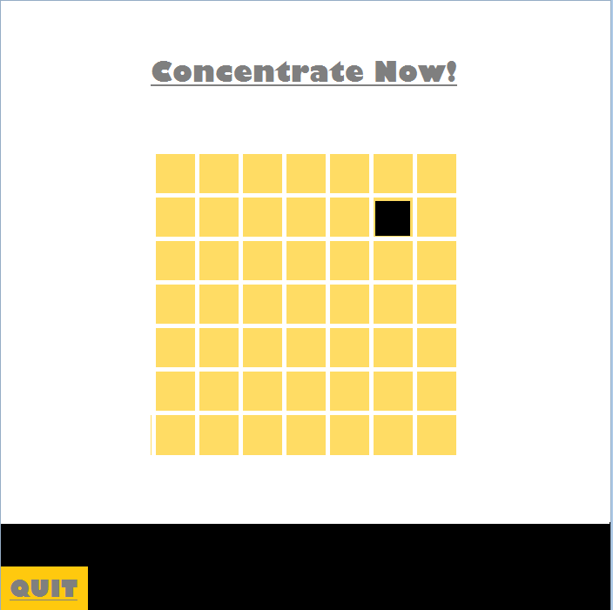

Tests Included

Slide 9








Basic Program Flowchart

Slide 10
PROGRAM CODE

Slide 11
PROGRAM OUTPUT

Slide 12

Reaction Time

Slide 13

Calculation

Slide 14

Vision

Slide 15

Memory

Slide 16
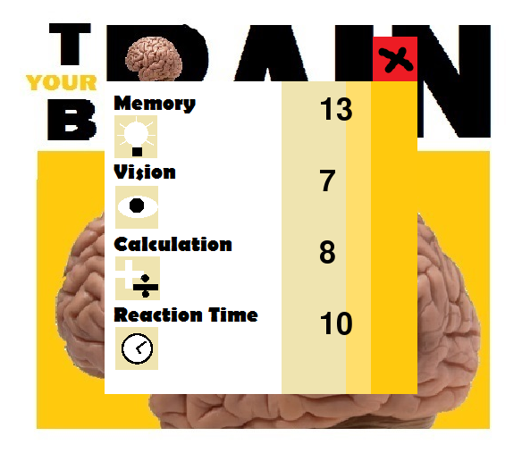
Score Menu

Slide 17
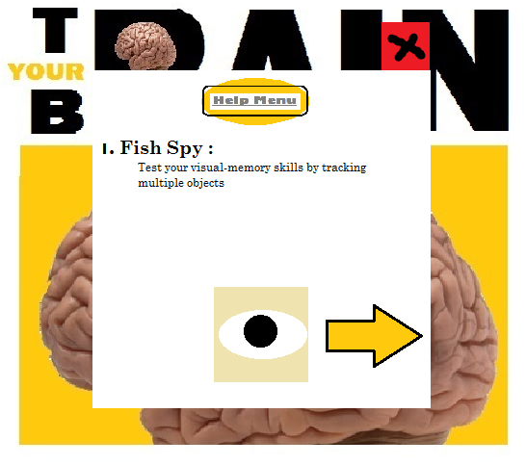
Help Menu

Slide 18
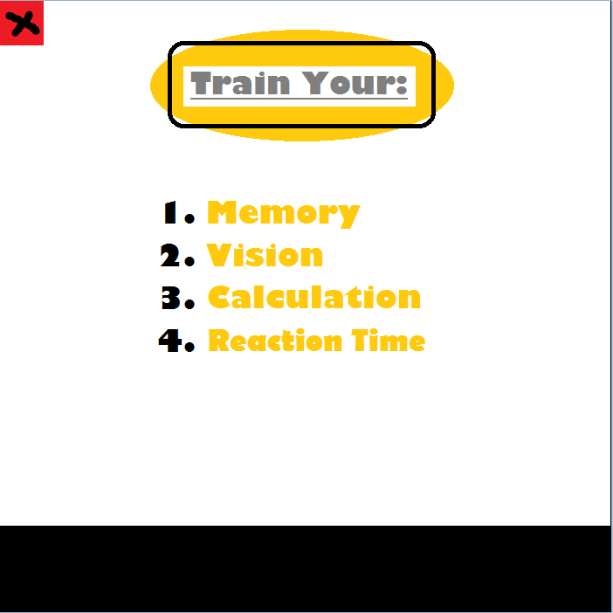
Game Chooser Menu

Slide 19
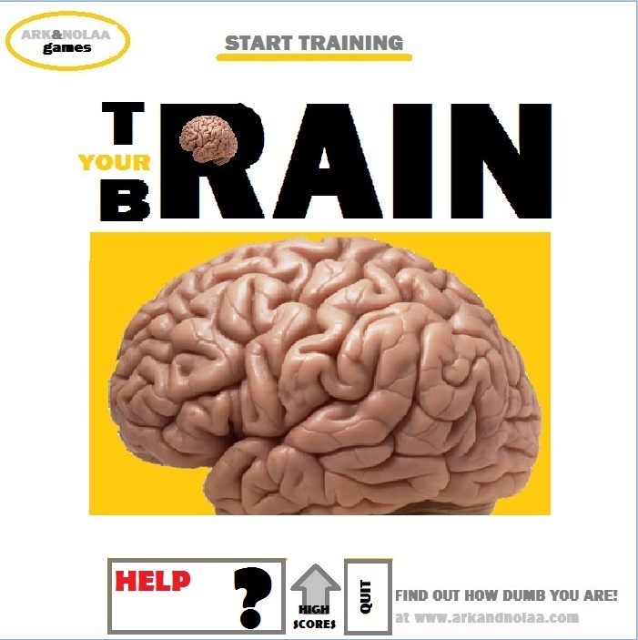
Start Screen

Slide 20
Conclusion
This project aims to train young minds to do the best they can with their minds. It has been a weary journey in the making of this. Atleast 30 manhours were spent in making it and its originality is unquestionable. The end result is this magnificent piece of art.

